Slide 1
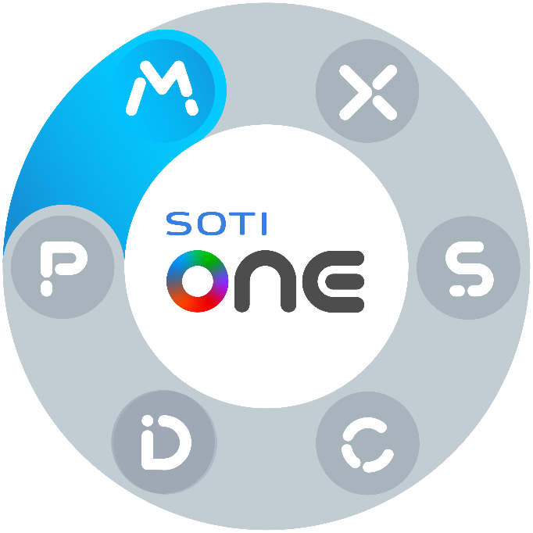


PRODUCT
OVERVIEW
SOTI Confidential - Only for use under NDA - Do not distribute

Slide 2


DEVICE MANAGEMENT CHALLENGES
IF DEVICES AREN’T MANAGED, THEY – AND YOUR ORGANIZATION – ARE AT RISK.
SECURITY
FLEET GROWTH
DOWNTIME
~1HR
56%
$1.4M
THE MEDIAN TIME FOR AN ATTACKER TO ACCESS YOUR PRIVATE INFORMATION THROUGH A PHISHING EMAIL¹
OF BUSINESSES FIND AN INCREASING PORTFOLIO OF MOBILE DEVICES HARD TO MANAGE²
THE ANNUAL COST FOR HELP DESK SUPPORT, IDLE TIME AND DIMINISHED PRODUCTIVITY³
1. Celebrate 20 Years of Cybersecurity Awareness Month with Microsoft
2. SOTI, Mobility in Motion: When Technology Transformation Meets Operational Intelligence
3. Health Tech World: Healthcare Organizations Hardest Hit by Device Downtime
Notes:
Presenter Notes:
Ask the audience questions:
Can your organization handle a security breach?
Do you have total visibility into ALL your devices?
Are you prepared to handle device downtime?

Slide 3


WHAT IS
SOTI MOBICONTROL?

Slide 4











PROVEN MOBILITY MANAGEMENT
Broadest OS Support
Android Plus Technology
SOTI XTreme Technology
Out-of-the-box Remote Support
SOTI Confidential - Only for use under NDA - Do not distribute
Notes:
Our journey through the SOTI ONE Platform begins with our flagship product MobiControl. MobiControl is an enterprise mobile management product that is being used by 1000’s of clients globally as highlighted in a prior slide. MobiControl allows these organizations to gain visibility, take action on and control their mobile landscape. Most importantly it enables you to empower your frontline workers and drive operational efficiencies. It brings your mobile management needs to a single console under a single pane of glass.
MobiControl has over 6000+ features but I will tell you about a real-life specific use cases where our customer used MobiControl to make an impact to their company.
One of our major U.S. retailers had migrated to Android devices in their warehouse and they were experiencing a 20% loss of devices every single year. So what was the impact to the business? As you know these devices are not cheap they are approximately $3,000-$4,000 depending on the device that you choose. Call it $3,000 on average for one of these devices. A 20% loss of inventory translates to over $600,000 a year in lost devices. That loss is huge for any organization. Our customer had a mandate to bring it down to 7%. In order to achieve this 13% reduction, they deployed MobiControl control on the new devices. They solved this by leveraging our polygonal geo-fencing that allows you to actually draw lines right around the exact shape of your building. The best part about it is once that device leaves that particular location, you can trigger an alert to take action and that’s exactly what they did. They were able to set up the right alerts and actions, and not only were they able to hit the 7% mark, they were actually able to bring it down to 4%. Huge savings! This half a million dollar impact was from one feature set alone. Imagine the profound impact you can have by leveraging MobiControl to its full capabilities. Again, whether you want visibility, the ability to take action, the ability to take control MobiControl will give you that and more. MobiControl will truly allow you to mobilize your workforce.

Slide 5
SOTI MobiControl
SIMPLIFYING MANAGEMENT OF MULTI-FORM-FACTOR & MULTI-OPERATING-SYSTEM DEVICES
FAST DEPLOYMENT
PROACTIVE MONITORING
Get devices into the hands of your workers fast and ready-to-go.
Always know what your devices are doing and ensure compliance.
POWERFUL SECURITY
ACCURATE TRACKING
Protect data, services and workers against theft and threats.
Determine device location and movement in real-time.
Notes:
Fast Deployment
SOTI MobiControl offers many different methods for rapid enrollment and provisioning, including: SOTI Stage, Apple DEP, Android Zero-Touch Enrollment, Samsung KME, Windows Autopilot and Zebra StageNow
Configure Wi-Fi/VPN and device settings and features
Manage and support any deployment scenario: Bring Your Own Device (BYOD), Corporately Owned, Business Only (COBO), Choose Your Own Device (CYOD) and Corporately Owned, Personally Enabled (COPE)
Powerful Security
Wipe corporate data if devices are lost or stolen
Lockdown corporate devices
Keep data safe with file encryption
Remotely lock, wipe or back-up devices
Restrict applications and features
Authenticate user access to corporate data
Proactive Monitoring
Detect unsecured, jail broken, rooted devices
Receive location-based alerts based on geofences
Ensure devices are compliant with corporate policies
Accurate Tracking
Track where devices have been
Find lost or stolen devices
Know what devices have which software on them

Slide 6
SOTI MobiControl
SIMPLIFYING THE MANAGEMENT OF MULTI-FORM-FACTOR & MULTI-OPERATING-SYSTEM DEVICES
Integrate SOTI MobiControl with SOTI XSight to resolve mobility issues and gain insights to reduce the operating costs of business mobility.
Operational Intelligence¹ to keep your business running smoothly
Real-time Visualization² into your mobile fleet
and business operations
Advanced Diagnostics and rich troubleshooting tools
Alerting Systems¹ to notify you when key measures impact device operations in the field
Troubleshoot device issues with Live Support¹ to reduce downtime anytime, anywhere
Incident Management for real-time visibility into issues
Operational Intelligence, Alerting Systems and Live Support only available for Android and Windows devices
Visualization analytics are available for Android, Windows and Linux devices.
Notes:
Operational Intelligence
Unlock key performance metrics about your device fleet. Easily recognize areas that impact operational costs and make smarter, data-driven decisions to improve your mobile strategy and maintain peak efficiency.
Visualization
Visualize your operations in real-time. Gain a holistic view of your mobile operations by accessing device and business data together. Identify the root cause of problems and gain a deeper understanding of your business.
Advanced Diagnostics
Solve problems faster, reduce downtime and improve productivity for IT staff and end users. Remote Control into devices and access advanced tools to diagnose and solve issues within seconds.
Alerting Systems
Notify IT staff in real-time when key measures affect the operation of devices in the field. Avoid data overages, excessive battery drain, downtime from physical drops and more. Improve productivity, lower costs and minimize downtime.
Incident Management
Minimize problem resolution times and enable efficient support workflows. Easily submit and manage support tickets.
Live Support
Next-level support is available via live text, voice and video chat. Enhance the support experience with end users and keep your business running smoothly.

Slide 7
9 CRITICAL FEATURES
OF SOTI MOBICONTROL

Slide 8
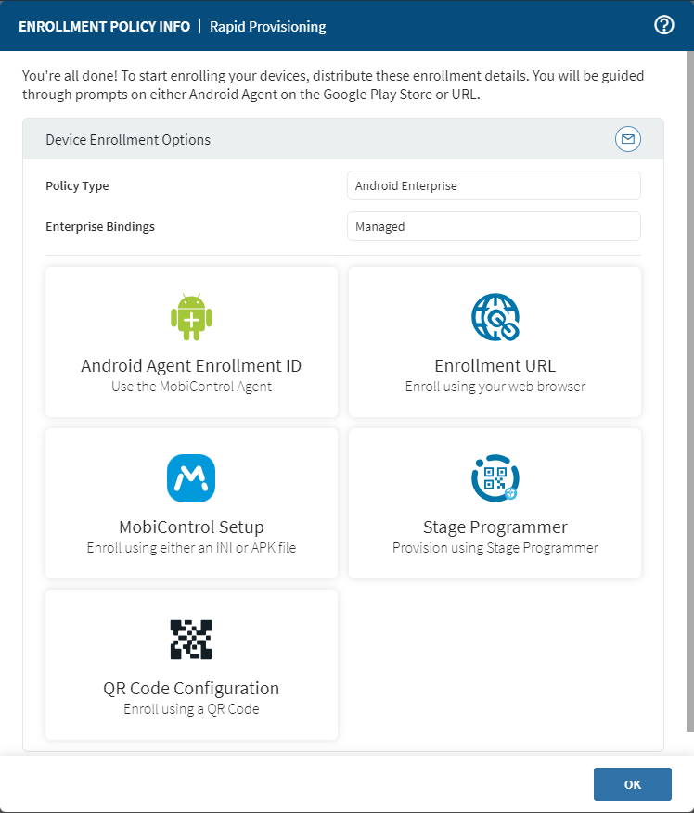
RAPID PROVISIONING
CHALLENGE
Provisioning devices is a time-consuming process
Workers don’t have the devices they need in a timely manner to be productive
HOW SOTI MOBICONTROL HELPS
Provision devices remotely using profiles and packages based on user role or geographic location
Use SOTI MobiControl Stage and third-party solutions to simplify device deployment
BENEFIT
Fast, consistent device provisioning
Devices can automatically perform provisioning tasks set by administrators (via barcodes generated by SOTI MobiControl Stage)
SOTI Confidential - Only for use under NDA - Do not distribute

Slide 9
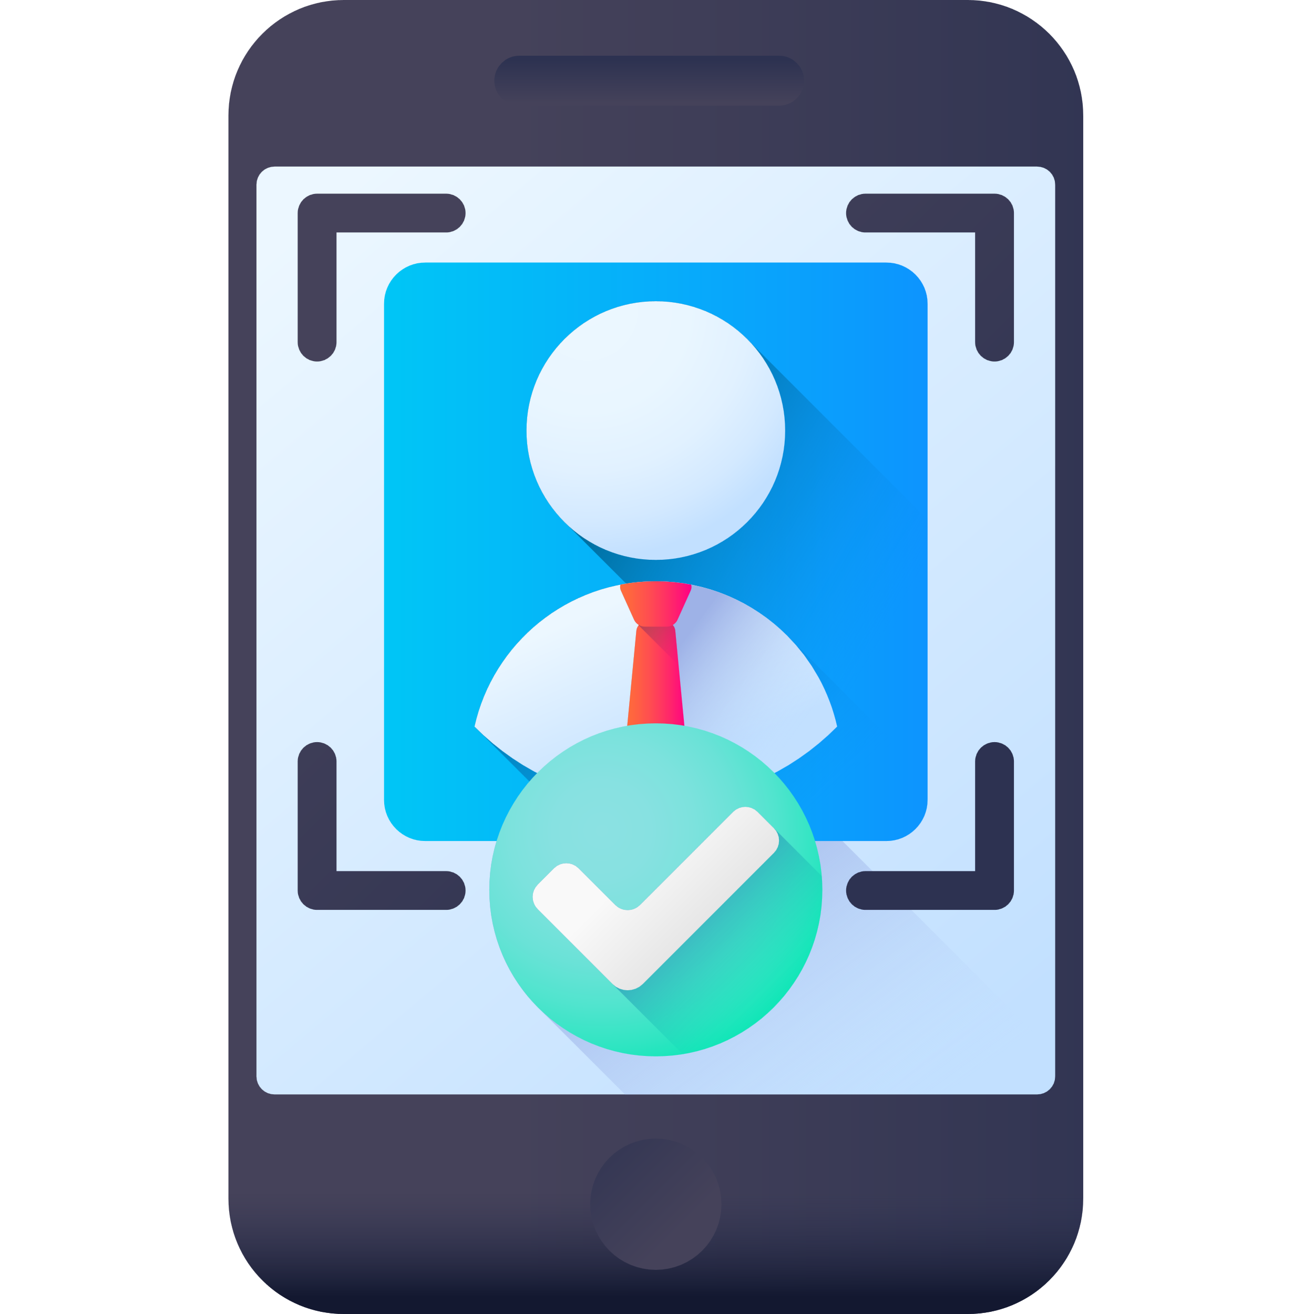
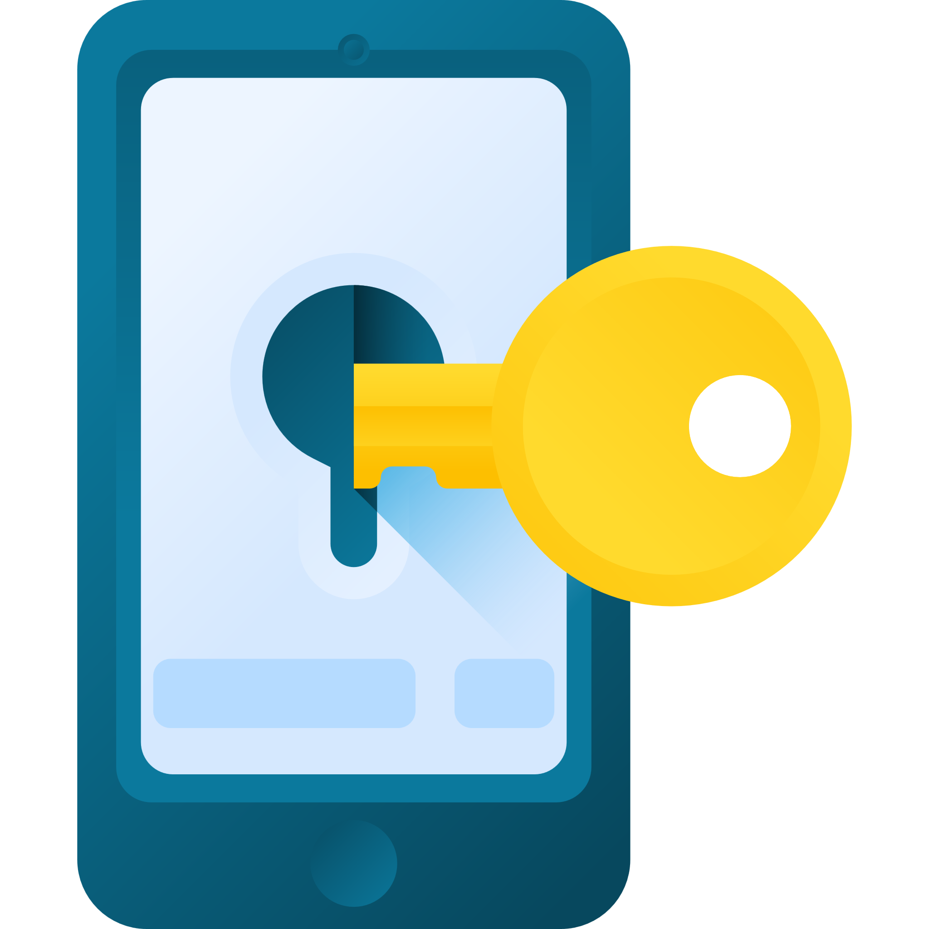
FLEXIBLE DEPLOYMENTS
CHALLENGE
An increase of mobile devices in the enterprise means more types of deployment scenarios to manage
HOW SOTI MOBICONTROL HELPS
Manage and support any deployment scenario: Bring Your Own Device (BYOD); Corporately Owned, Business Only (COBO); Choose Your Own Device (CYOD) and Corporately Owned, Personally Enabled (COPE)
BENEFIT
Provide flexible device management for all employees
Ensure all devices are ready for business and protected against threats
Make your organization a more appealing place for new talent
SOTI Confidential - Only for use under NDA - Do not distribute

Slide 10
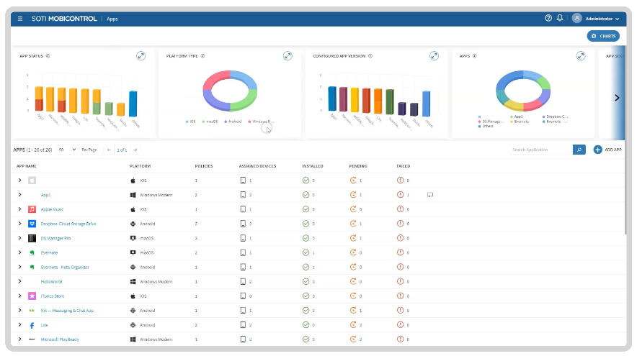
ROBUST APP MANAGEMENT
CHALLENGE
Workers aren’t productive when using incorrect or outdated versions of apps
HOW SOTI MOBICONTROL HELPS
Centralized management of Apps with the Apps Dashboard
Easy “one and done” multi-OS deployment of line-of-business (LOB) apps whenever required
BENEFIT
The Apps Dashboard enables you to easily monitor app statuses and unlock quick insights
Packages and profiles ensure the right versions of the right apps are installed for the right workers
SOTI Confidential - Only for use under NDA - Do not distribute

Slide 11
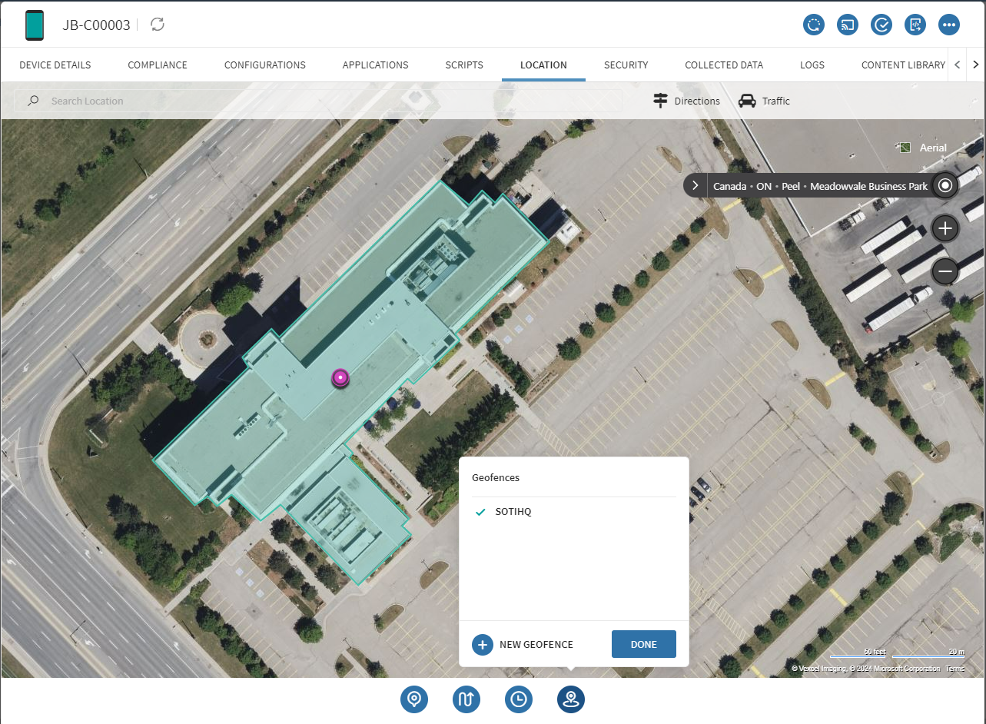
advanced GEOFENCING
CHALLENGE
Data on the move is at risk of theft when outside safe, secure networks
HOW SOTI MOBICONTROL HELPS
Advanced geofences enable the deployment of apps, policies and content based on precise visual maps
Track the physical location of devices in the field
and control what they can or can’t do based on
where they are
BENEFIT
Protect devices that are required to move between locations in case they are lost or stolen
Ensure sensitive data remains inaccessible to unauthorized users or in unauthorized locations
SOTI Confidential - Only for use under NDA - Do not distribute

Slide 12
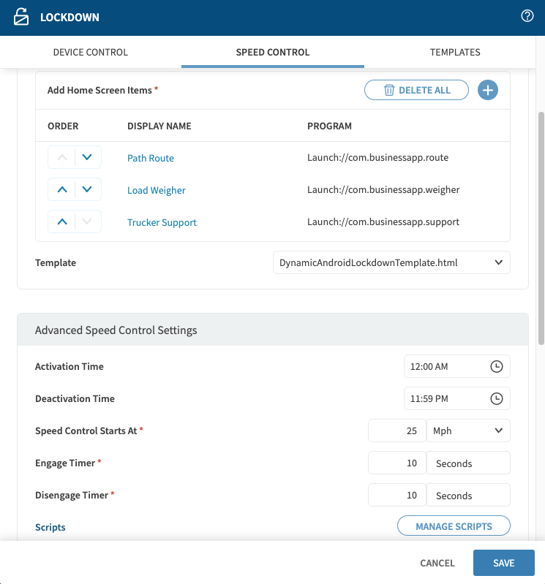
SPEED CONTROL LOCKDOWN
CHALLENGE
Distracted driving puts people and property at risk
Drivers accessing/using mobile devices when their eyes should be on the road
HOW SOTI MOBICONTROL HELPS
Speed lockdown limits device functionality when a speed threshold is exceeded
Full functionality is restored when the device is no longer in motion
BENEFIT
Enhanced safety
Reduce the risk of accidents, damages and fines associated with distracted driving
SOTI Confidential - Only for use under NDA - Do not distribute

Slide 13


MOBILE SECURITY
CHALLENGE
Devices and data are constantly at risk of virus and malware threats
Unsecured endpoints or Wi-Fi connections are open to attacks
HOW SOTI MOBICONTROL HELPS
Monitor systems and installed apps for malware and viruses
Prevent unauthorized access to systems and data
BENEFIT
Remotely protect all devices while maintaining regulatory compliance
Protect data safety, worker productivity and the company’s reputation
SOTI Confidential - Only for use under NDA - Do not distribute

Slide 14
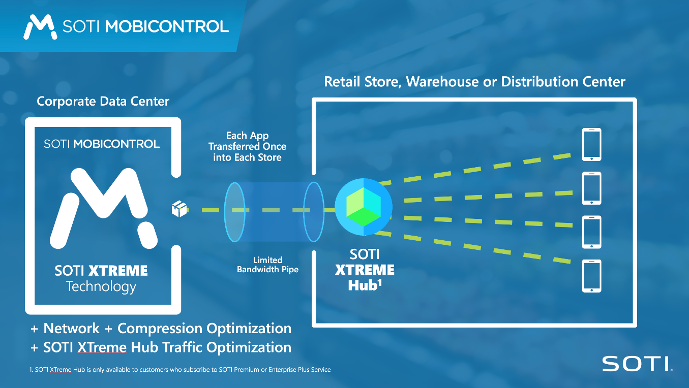
SOTI XTREME HUB TECHNOLOGY¹
CHALLENGE
Transferring large amounts of data, apps and files to mobile devices takes too much time and bandwidth
Workers don’t have the resources they need to effectively do their jobs
HOW SOTI MOBICONTROL HELPS
SOTI XTreme Hub Technology is built into
SOTI MobiControl
Network and compression optimization delivers data up to 10x faster
BENEFIT
End users receive the data they need without having to wait for staggered or scheduled delivery
1. Available only for SOTI Premium and Enterprise Plus Service customers
SOTI Confidential - Only for use under NDA - Do not distribute

Slide 15
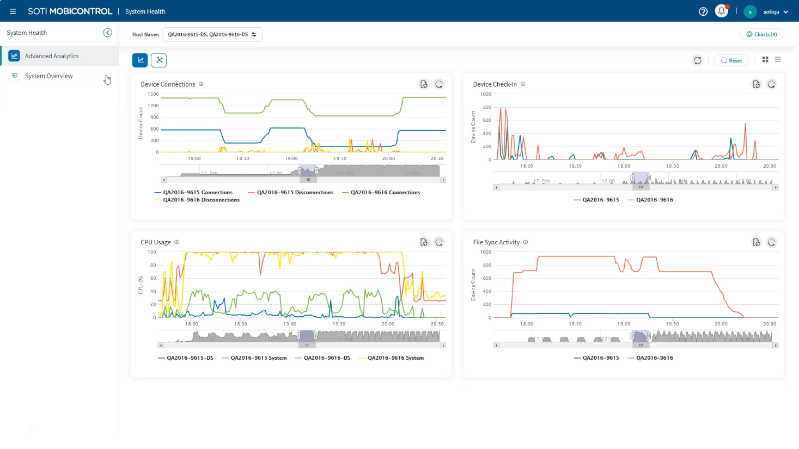
SYSTEM HEALTH DASHBOARD¹
CHALLENGE
Lack of visibility into what system operations slow down package delivery or which database queries are not executing optimally
HOW SOTI MOBICONTROL HELPS
The System Health Dashboard offers rich information to maximize SOTI MobiControl
Identify bottlenecks that slow down SOTI MobiControl’s ability to perform critical tasks
BENEFIT
Take data-driven actions to maximize the efficiency and effectiveness of SOTI MobiControl
Prioritize essential tasks to ensure remote workers have the packages they need to be productive
1. Available only for SOTI Premium and Enterprise Plus Service customers
SOTI Confidential - Only for use under NDA - Do not distribute

Slide 16
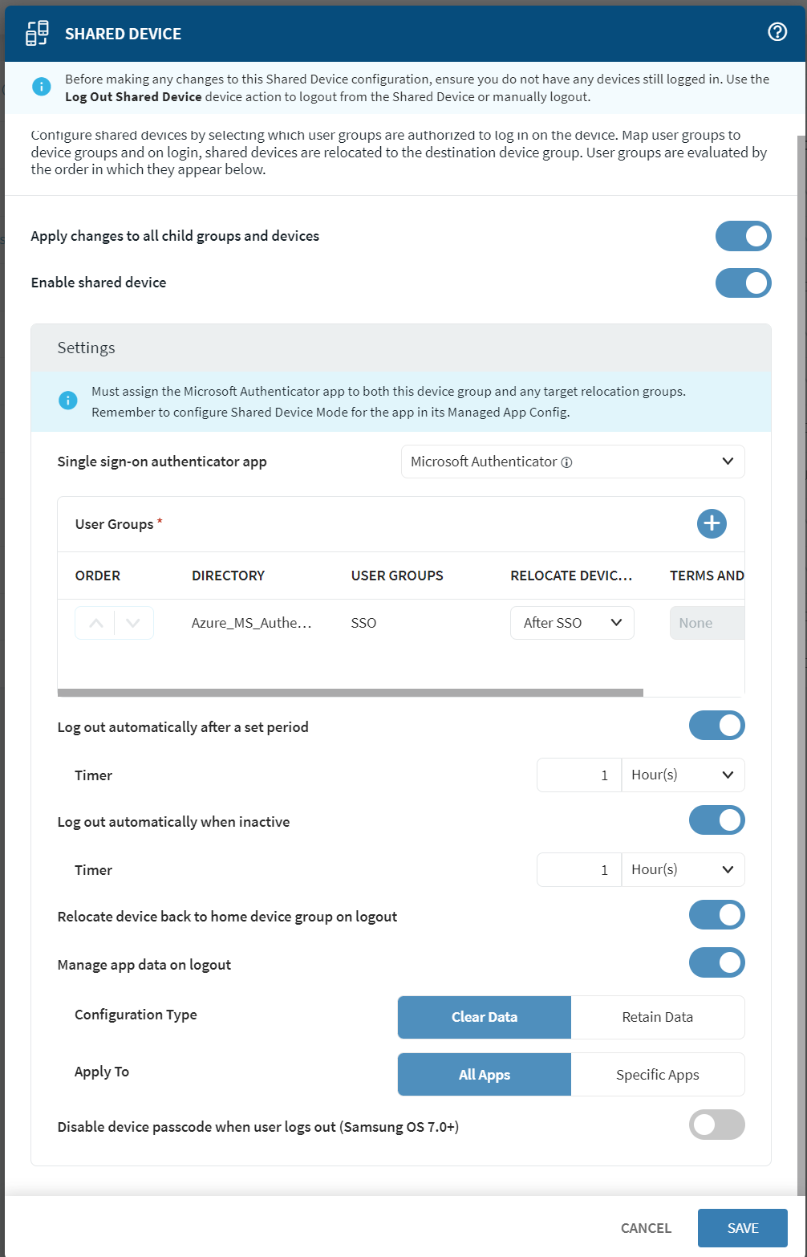
SHARED DEVICE CONFIGURATION
CHALLENGE
Inability to safely and seamlessly share devices among workers and shifts
Data is not protected and controlled as devices are passed from one worker to the next
Organizations must provide each worker with their own device, increasing capital expenditure (CAPEX) costs
HOW SOTI MOBICONTROL HELPS
Shared Device Configuration controls how shared devices behave when accessed by authorized users
Support for Google Android devices, Microsoft Shared Device Mode, Shared iPad for Business
BENEFIT
Reduced expenses associated with individual device allocations, enabling resource optimization
Device management becomes simplified, as IT can focus on a smaller pool of devices
Productivity increases, as employees always have access to the devices and data they need

Slide 17
WHAT’S NEW IN
SOTI Mobicontrol 2025

Slide 18
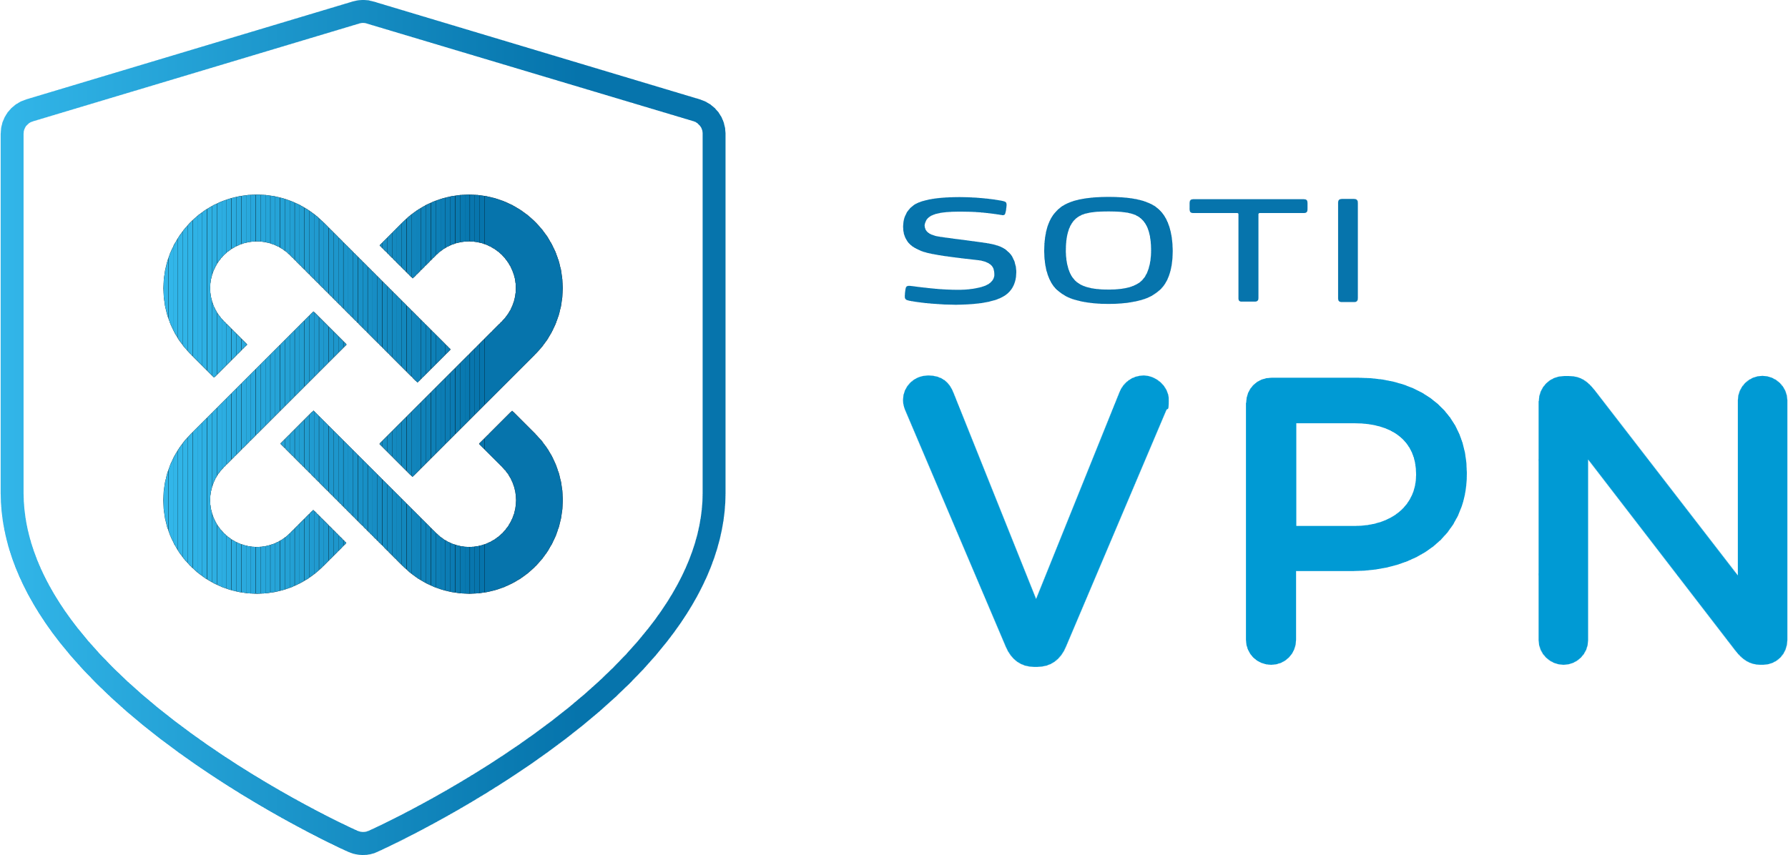
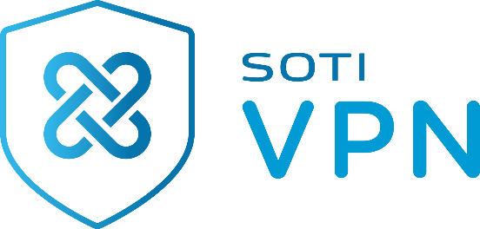


Optimize Your Devices with SOTI VPN
Now available for Android, Windows, iOS and iPadOS devices
With SOTI VPN, employees can unlock protected information securely wherever they are.
Unlike a traditional VPN, it is designed to work in the background.
Users get frictionless, secure access.
With device-wide, per-app and split tunnel modes of operation, employees can unlock protected information wherever they are and in a secure way.
Available only for SOTI Premium and Enterprise Plus Service customers
Notes:
SOTI VPN is a new feature that is now offered for Android, Windows, iOS and iPadOS devices. It allows users to securely access the network services they need, wherever they are. When mobile devices are on untrusted networks, such as public cellular networks, the common solution is a VPN. However, typical VPNs are not well-suited for business-critical use cases, as they require the device user to initiate the VPN session and/or provide a username and password. To combat this, SOTI VPN has been specifically designed to avoid these impediments, ensuring the user experience is frictionless. This unique feature allows employees to unlock protected information wherever they are and in a secure way, helping them stay productive, while your business remains protected.

Slide 19




Samsung Knox e-fota
SOTI MobiControl offers the first single pane of glass experience with Samsung Knox E-FOTA
CENTRALIZE
MANAGEMENT
ENHANCE SECURITY
TEST
UPDATES
SCHEDULE UPDATES
Control firmware
and OS updates without leaving the SOTI MobiControl console you know and trust.
Equip devices with the latest security updates to combat emerging threats.
Beta-test OS versions with a sample group and deploy without surprises.
Choose when an OS version will be updated to accommodate business operations and minimize disruptions.
Notes:
We are excited to announce a new integration between SOTI MobiControl and Samsung Knox E-FOTA. You can now control when firmware and operating system (OS) updates occur on Samsung Galaxy devices without leaving the SOTI MobiControl console that you know and trust.
As the first Enterprise Mobility Management (EMM) solution to provide a single pane of glass experience with Knox E-FOTA, you can now get even more out of your SOTI MobiControl console. Track, manage and secure Samsung Galaxy devices from unboxing to retirement seamlessly.

Slide 20
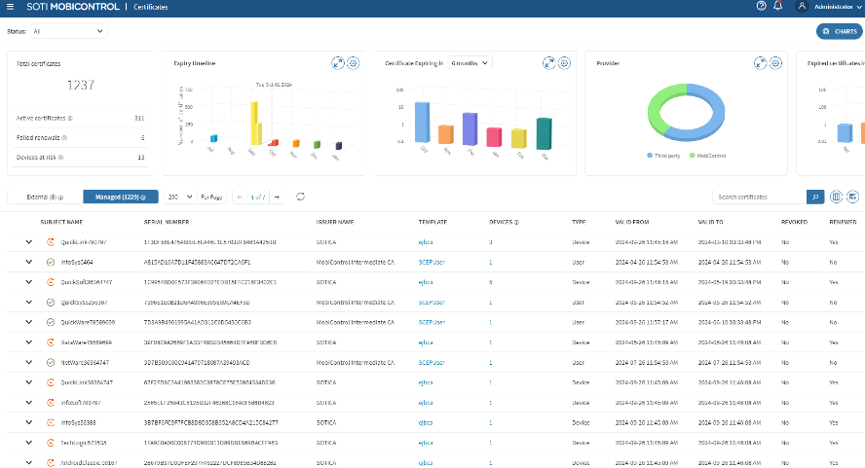
DASHBOARDS TO INCREASE EFFICIENCY
APPS DASHBOARD
CERTIFICATES DASHBOARD
Monitor app statuses for all the apps deployed via App Policies.
Access an overview of your device certificate landscape, enhancing management and preventing lapses.
Notes:
The SOTI MobiControl Apps Dashboard features five key charts, which offer quick insights into different aspects of your app environment. This gives you full visibility to monitor app statuses and easily troubleshoot issues as needed. This dashboard combats unexpected downtime and disruptions for your business-critical apps by preventing failed downloads, enhancing employee productivity in the field and elevating customer experiences.
With the SOTI MobiControl Certificates Dashboard, you can maximize management by accessing expiry dates, identifying at-risk devices and ensuring smooth device performance. With the help of easy-to-read, customizable charts, you can quickly consume valuable information and action it accordingly.

Slide 21
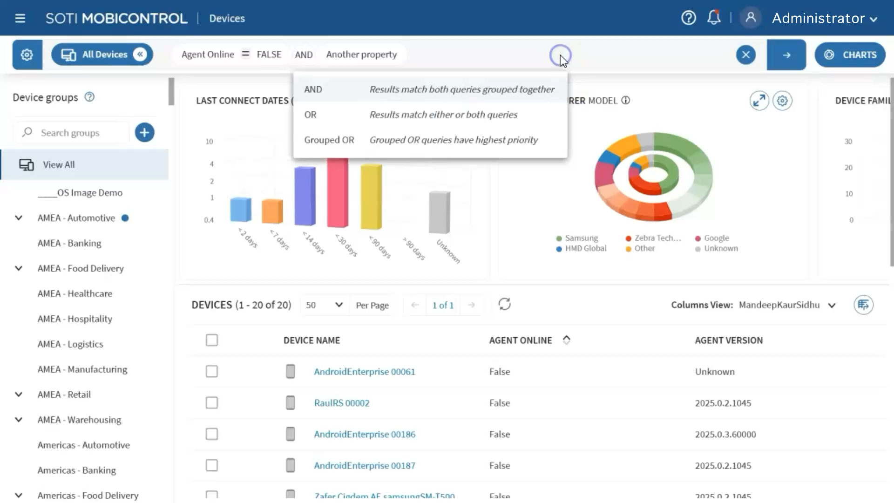
Dashboards to increase efficiency
SHARED VIEWS & SEARCHES ON
THE DEVICES DASHBOARD
Share custom column views and saved searches with other users, roles and groups to streamline collaboration.
Notes:
With the Devices Dashboard on SOTI MobiControl, IT Admins can now share custom column views and saved searches with other users, roles and groups.
Simply put, console users no longer need to manually recreate column views and saved searches. This feature saves time, streamlines collaboration, provides consistent access to relevant data and enhances efficiency in device management workflows.

Slide 22
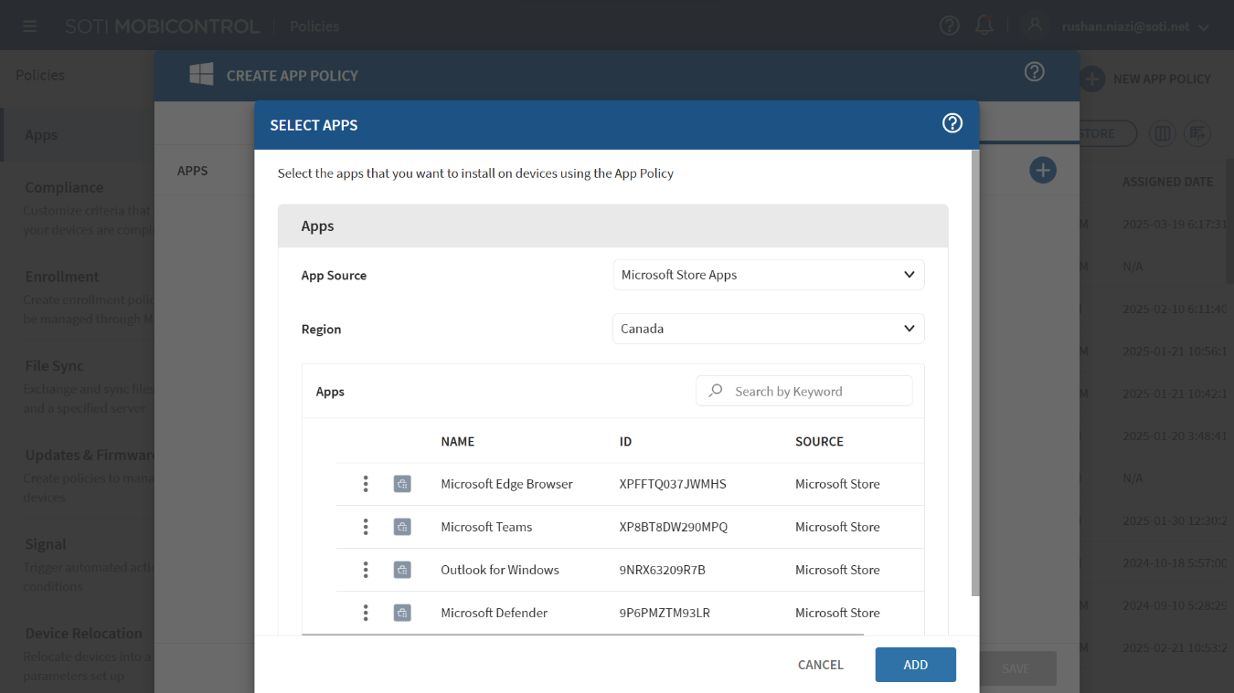
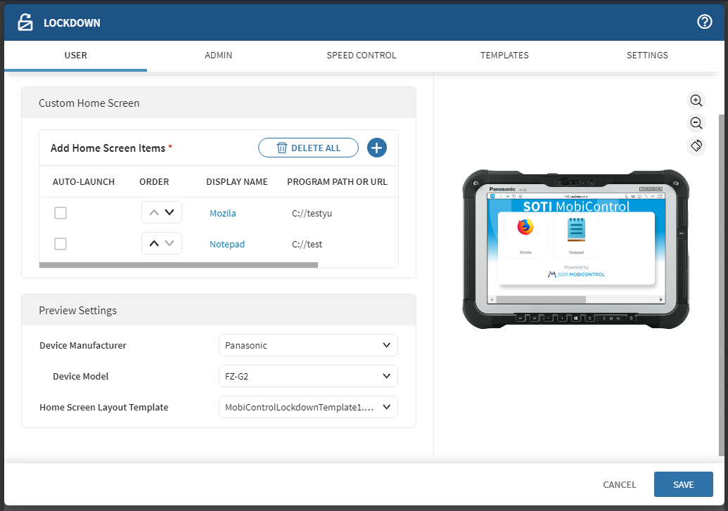
Windows updates
APP DEPLOYMENT
LOCKDOWN
Enhanced experience when installing, configuring and deploying apps.
Easily design lockdown configurations for various apps and settings to control a device’s access.
Notes:
Elevate your app deployments for Windows devices with an enhanced user interface. Deploy Microsoft Store and enterprise (.exe) apps through the Windows Modern app policy for a better app deployment experience.
With Lockdown for Windows, your organization can easily design lockdown configurations for various apps and settings to control a device’s access. This ensures your devices are secure, while sitting idle, and productive by promoting important and promotional campaigns. For each configuration, you can also use a live screen preview to confirm the Lockdown screen is exactly what you want.

Slide 23
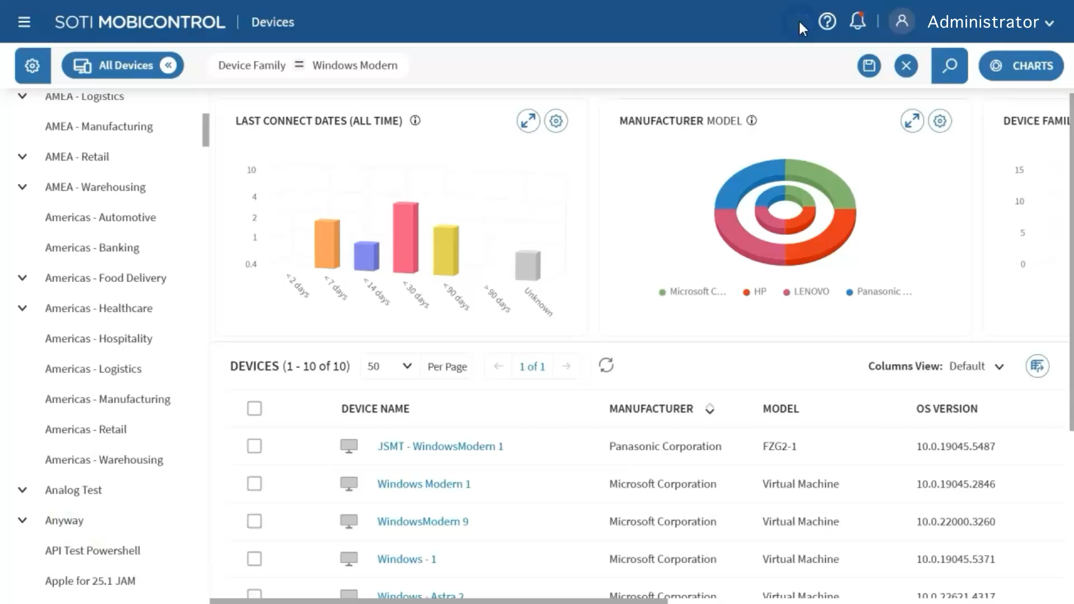
Windows updates
HARDWARE & PERIPHERAL VISIBILITY FOR WINDOWS DEVICES
View and monitor any hardware components or connected peripherals on Windows devices.
Notes:
You can now easily view and monitor any hardware components and connected peripherals – such as keyboards or cables – on Windows devices.
Without visibility into your hardware assets or peripherals, you may experience process inefficiencies, higher replacement costs and challenges tracking and optimizing their usage.

Slide 24
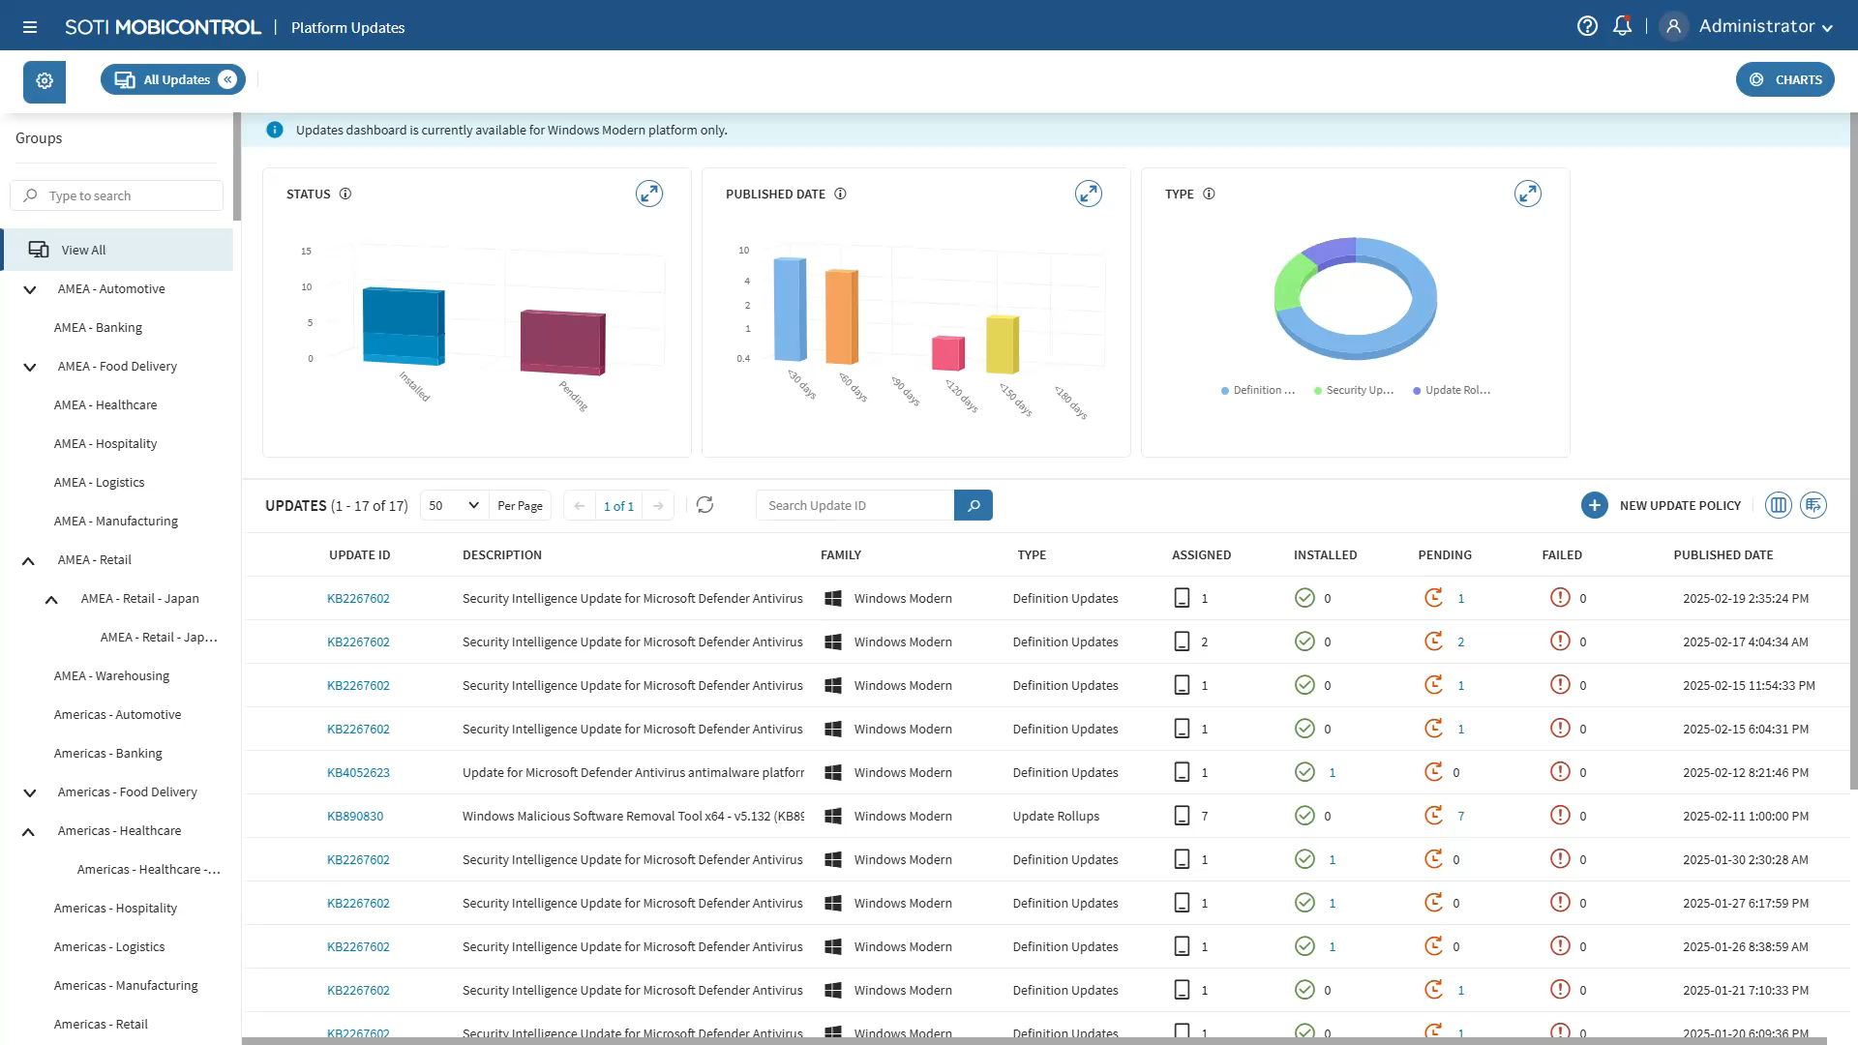
Windows updates
PLATFORM UPDATES DASHBOARD
Easily manage and monitor patches and updates across
all Windows devices.
MAKE WINDOWS OS IMAGING EFFORTLESS
With large-scale imaging capabilities, the Windows OS imaging process is simpler and more efficient.
Notes:
Unlock the Platform Updates Dashboard for Windows Devices
Looking for a new way to manage and monitor your Windows device and app updates? The new Platform Updates Dashboard in SOTI MobiControl is the perfect solution.
With a single, convenient interface, IT Admins will no longer struggle to manage and monitor patches and updates across all devices. This centralized dashboard enables comprehensive patch management, using real-time monitoring for patch statuses and deployment progress. It also allows IT Admins to easily monitor and approve patches in bulk, as well as deploy patches directly from the dashboard.Furthermore, having visibility into and control over the firmware, updates and patches on all devices, you can ensure they remain protected against security threats and vulnerabilities.
Make Windows OS Imaging Effortless
Does creating and deploying OS images across Windows devices take too long? SOTI MobiControl now uses large-scale imaging capabilities, which makes the entire process more efficient, saving valuable time and effort.

Slide 25
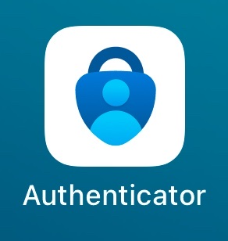

APPLE UPDATES
DECLARATIVE DEVICE MANAGEMENT
MICROSOFT AUTHENTICATOR SINGLE SIGN ON PAYLOAD
Enhance your iOS and iPadOS management methods with Apple’s Declarative Device Management (DDM) protocol in SOTI MobiControl.
Automatic device registration and user authentication – keeping your devices secure and employees productive.
Notes:
DDM
Enhance your iOS and iPadOS management methods using Apple’s Declarative Device Management (DDM) protocol in SOTI MobiControl. When managing a fleet of iPhones and/or iPads, the goal for any organization is to precisely configure your devices to reduce network traffic and maintain both security and efficiency. However, configuring each device with the latest settings using traditional management methods is time-consuming. With SOTI MobiControl and Apple DDM, all device profile creation and deployment can be streamlined. DDM will also reduce network bandwidth and allow each device to apply configurations based on your own logical conditions. With such a proactive approach, your devices will be secure, compliant and productive.
Microsoft Authenticator Single Sign-On Payload
Looking to increase the security of iOS and iPadOS devices and productivity of users? Signing into essential apps multiple times throughout the workday is inefficient and error prone. The risk of security breaches also rises when a device is exposed to multiple user and password inputs. To combat these inefficiencies, register your iOS and iPadOS devices with Microsoft Entra ID and perform single sign-on with Microsoft Authentication enabled apps. Your SSO profile will seamlessly integrate with Microsoft Authenticator for automatic device registration and user authentication – keeping your devices secure and employees productive.

Slide 26
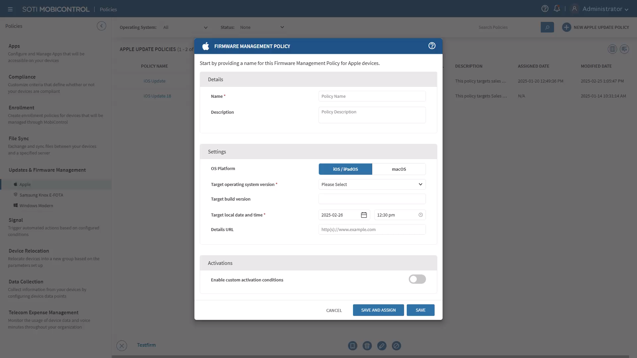
APPLE UPDATES
UPDATED FIRMWARE POLICIES
Simplify the administration and enforcement of firmware policies on iOS and iPadOS devices.
Notes:
When an organization has many Apple devices, fulfilling operating system updates for each one is tedious and time-consuming. Consequently, firmware update delays put IT Admins at risk of not meeting compliance regulations or their organization’s security initiatives. SOTI MobiControl 2025.1 has simplified the administration and enforcement of firmware policies. Now, you can easily schedule updates on Apple iOS, iPadOS and macOS powered devices. This improves device management by enhancing overall security and compliance monitoring.

Slide 27
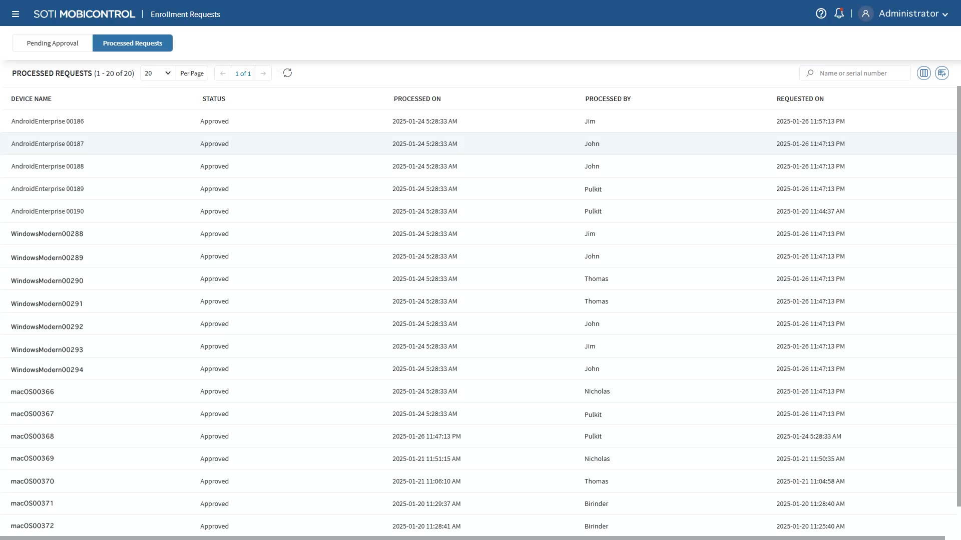
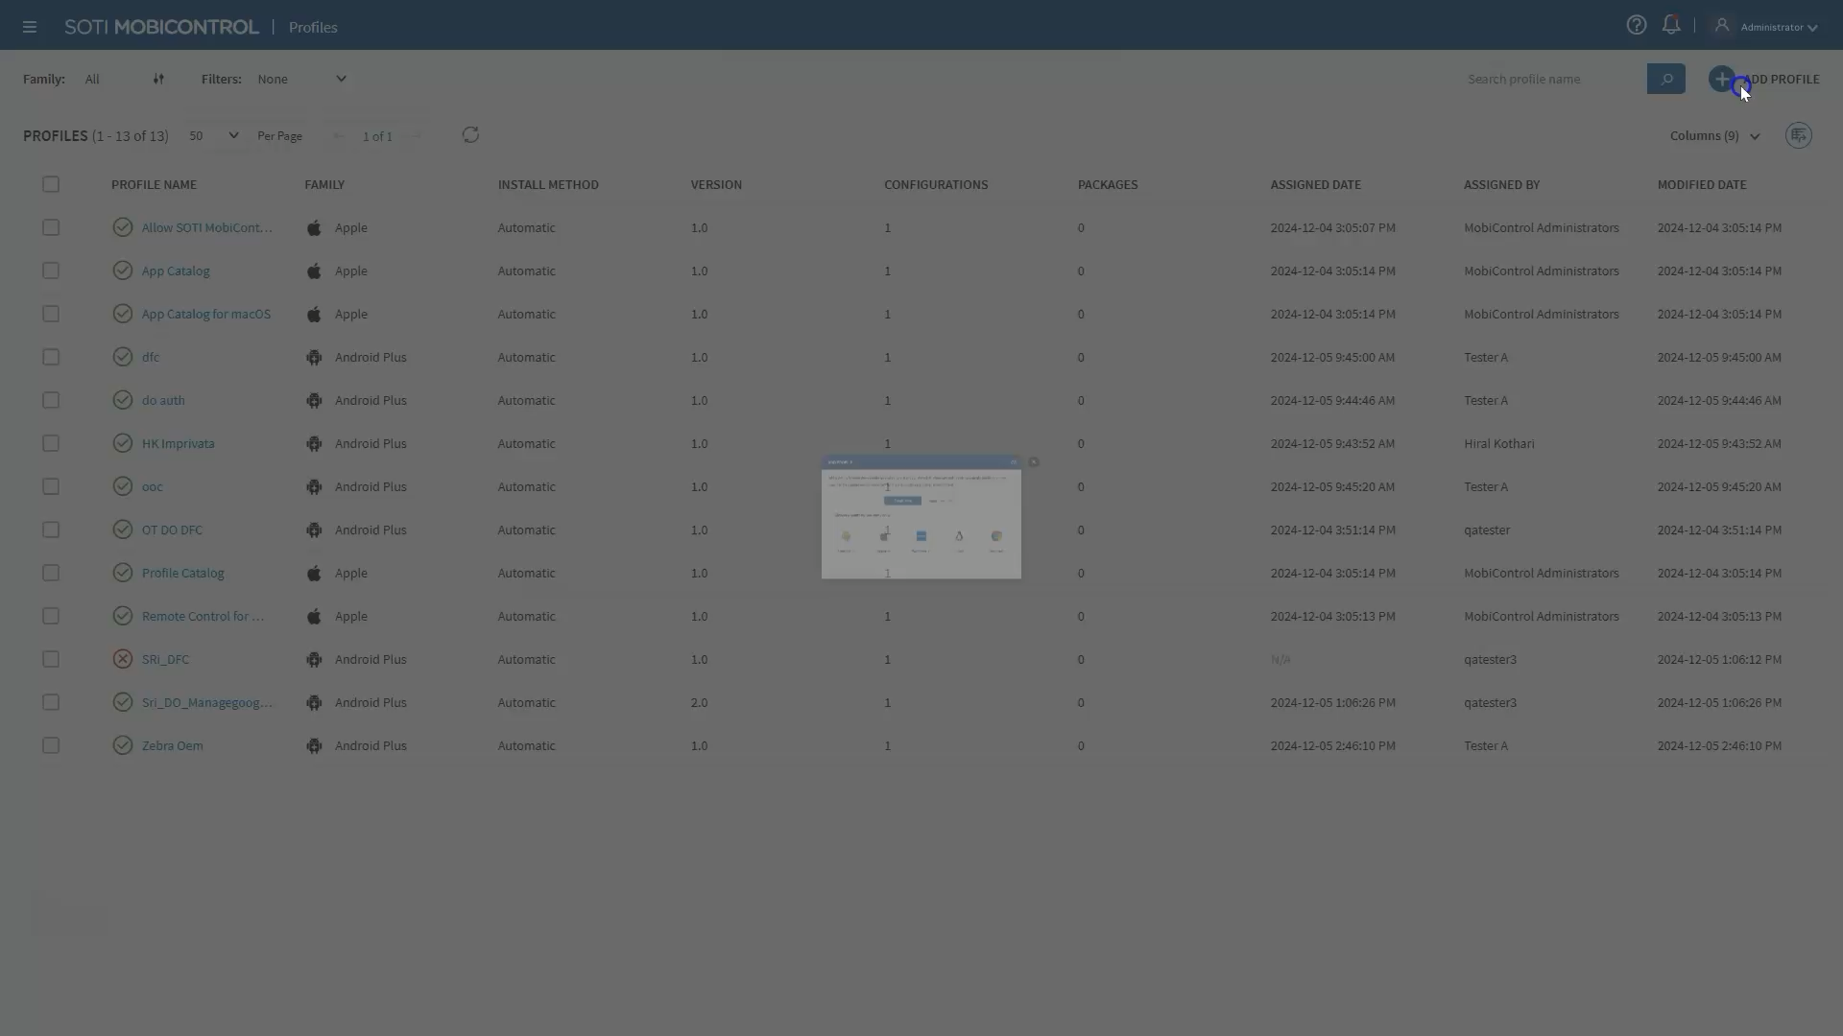
NEW console updates
CONTROL APP ACCESS TO CELLULAR & WI-FI NETWORKS
REVIEW & APPROVE DEVICE ENROLLMENTS
Easily review and approve device enrollments to ensure only authorized devices gain access to SOTI MobiControl.
Block apps from specific cellular or Wi-Fi networks to safeguard sensitive information and regulate data consumption on Android devices.
Notes:
Review & Approve Device Enrollments
Unlock a method of ensuring that all devices that enroll are authorized to. With SOTI MobiControl, you can easily review and approve device enrollments. This way, only authorized devices gain access to SOTI MobiControl, maintaining organizational control and regulatory compliance.
Control App Access to Cellular & Wi-Fi Networks
Some Wi-Fi or cellular networks are not secure, which means connecting to them poses a security risk for your organization’s devices. With SOTI MobiControl, you can block apps from specific cellular or Wi-Fi networks, safeguarding your sensitive information. This feature also allows you to regulate data consumption on Android devices, identify data overages and reduce high data costs moving forward.

Slide 28




SOTI xtreme hub enhancements
Multiple XTreme Hubs
Android App Support
IP-Based Certificate Binding
Automatic Fallback
Assign multiple XTreme Hubs to a device group to ensure flexible and robust data deployments.
Unlock Android app support through SOTI MobiControl App Policies.
Utilize secure IP-based certificate binding for enhanced device protection.
Set up an automatic back-up to the Deployment Server to ensure seamless data deployment.
Available only for SOTI Premium and Enterprise Plus Service customers
Notes:
What is SOTI XTreme Hub? When a device is chosen to be an XTreme Hub, it distributes data to other devices, instead of a server sending data to hundreds of devices. This process reduces server load and streamlines the method of data distribution.
Multiple XTreme Hubs: Assign multiple XTreme Hubs to a device group to ensure flexible and robust data deployments.
Android App Support: Unlock Android app support through SOTI MobiControl App Policies
IP-Based Certificate Binding: Utilize secure IP-based certificate binding for enhanced device protection.
Automatic Fallback: Set up an automatic back-up to the Deployment Service to ensure seamless data deployment. In the event your chosen XTreme Hub is not accessible, this back-up will ensure the data is deployed seamlessly.

Slide 29

SOTI MobiControl has numerous features to help you better manage your business-critical mobile operations, including…
Direct managed app configurations
Controlled access to Microsoft 365 apps
Granular permissions
Customized SOTI Surf browser branding
Multi-file uploads to content libraries
High availability/load balancing for Cloud Link Agent (CLA)
Offline OEMConfig
Shared devices for Android and iOS
Zebra Lifeguard OTA
Windows Modern management
…and more time-saving, money-saving and device and data protecting features are coming in future versions of SOTI MobiControl.

Slide 30


Thank you
www.kreski.pl
© 2024, SOTI Inc. All Rights Reserved

